Slide 1
SILVERSCREEN CINEMA
Performance Analytics Project
Analysis of the efficiency of 3 locations in New Jersey
Analysis of rental costs vs. revenue
Presented by: Alexander Kuhn
Date: 06.10.2025

Slide 2
Business Goals
Business Goals:
Analysis of the efficiency of 3 Silver Screen cinemas in New Jersey
Understanding the relationship between film distribution costs and revenue
Identification of profitable vs. unprofitable films and locations

Slide 3
Business Challenge
1.Situation:
Silver Screen operates three movie theaters in New Jersey
Unterschiedliche Datenquellen pro Standort
No central overview of profitability
Management requires a data-driven basis for decision-making

Slide 4
Business Challenge
2. Project objectives:
Data consolidation
Integration of 5 different data sources
Consistent data model
Monthly aggregation
Efficiency analysis
Cost-benefit ratio per film
Performance comparison of the 3 locations
ROI calculation and profitability tracking
Decision support
Interactive dashboard for management
Identification of optimization potential
Data-driven recommendations

Slide 5
DATA SOURCES OVERVIEW
Data source matrix
Source | Location | Lines / Rows | Description
nj_001.csv | Newark | 112,323 | Transaction data (detailed)
nj_002.csv | Jersey City | 1,478 | Daily aggregation
nj_003.csv | Trenton | 212,250 | Transaction data (mixed)
invoices.csv | All 3 | 159 | Film distribution invoice
movie_catalogue.csv | Reference | 23 | Film Master Data

Slide 6
DBT CLOUD STRUCTUR
silverscreen_dbt/
├── models/
│ ├── staging/ # Layer 1: Raw → Staging
│ │ ├── _sources.yml # Quell-Definitions
│ │ ├── stg_sales.sql # Newark standardized
│ │ ├── stg_sales.sql # Jersey City standardized
│ │ ├── stg_sales.sql # Trenton standardized
│ │ ├── stg_invoices.sql # Rental Costs
│ │ └── stg_public_movie_catalouqe.sql # Film-Catalouqe
│ │
│ └── marts/ # Layer 2: Staging → Marts
│ ├── schema.yml # Tests & Documentation
│ └── silverscreen_monthly_revenue.sql # Final Modell
│
├── macros/ # Reusable functions
├── tests/ # Data quality tests
└── dbt_project.yml # Project configuration

Slide 7
DBT CLOUD STRUCTUR
Staging Layer:
Standardization of sources
Basic data types and column names
Minimal transformations
1:1 relationship with sources
Marts Layer:
Business logic aggregations
Joins across multiple sources
Calculated metrics (profit, ROI)
Reporting-ready Tables

Slide 8
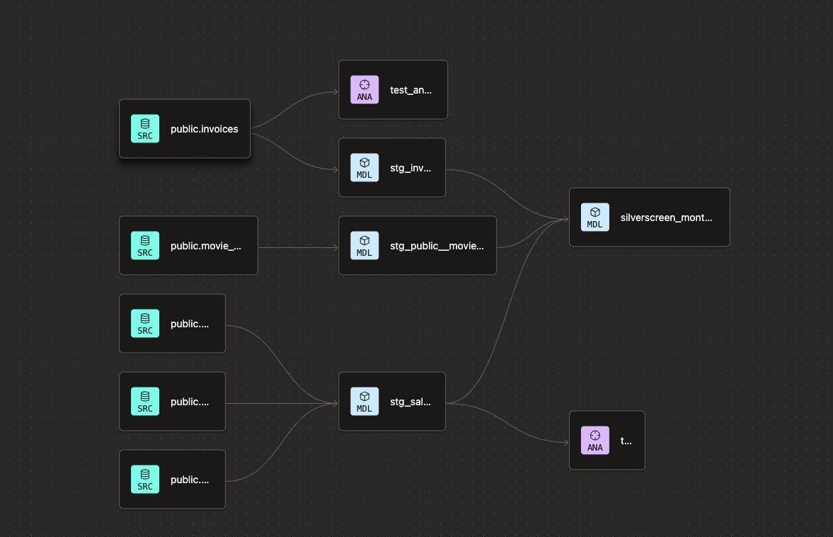
DBT MODEL DESIGN

Slide 9
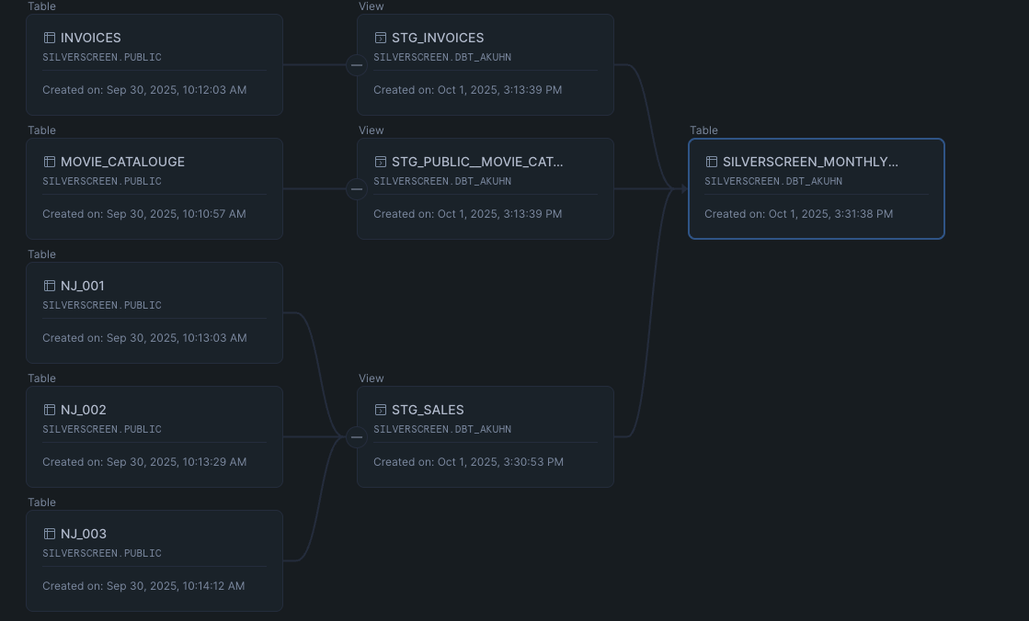
SNOWFLAKE MODEL DESIGN

Slide 10
FINAL DATA MODEL
Rows:
159
23 unique movies
3 locations
~2-3 months per movie/location
Primary Key:
movie_id + location_id + month
Each combination exists only once
No duplicates
Complete granularity

Slide 11
FINAL DATA MODEL
 | Column | Typ | Description
1 | Movie_ID | STRING | Unique film ID
2 | Movie_Titel | STRING | Movie Titel
3 | Genre | STRING | Movie Genre
4 | Studio | STRING | Production Studio
5 | Month | STRING | Month (YYYY-MM)
6 | Location ID | STRING | Location of the Theater
7 | Rental_Cost | INT | monthly Rental Cost
8 | Tickets_Sold | INT | Tickets sold
9 | Revenue | INT | Ticket revenue

Slide 12
OVERALL Performance
Metric | Value | Status
Total Revenue | 13,8M $ | OK
Total Rental Cost | 21,0M $ | renegotiate
Total Profit | -7,2M $ | NOK
AVG ROI | -35% | NOK
Profitable Films | 40 % | Increase necessary
CRITICAL: Rental costs exceed revenue by 52%

Slide 13
Location Performance
Location | Revenue | Costs | Profit
Newark (NJ-001) | 5,2M $ | 6,8M $ | -1,6M $ (best ROI: -23%)
Jersey City (NJ-002) | 4,8M $ | 7,5M $ | -2,7M $ (ROI: -36%)
Trenton (NJ-003) | 3,8M $ | 6,7M $ | -2,9M $ (worst ROI: -43%)

Slide 14
FILM Performance
Top 3 Profitable Movies:
1. Avatar (Sci-Fi) → +125K $ Profit
2. Top Gun (Action) → +98K $ Profit
3. Oppenheimer (Drama) → +87K $ Profit
Genre-Performance:
Sci-Fi: +12% ROI (beste Genre)
Drama: +8% ROI
Comedy: -5% ROI
Action: -42% ROI (schlechteste)
Bottom 3 (Größte Verluste):
1. Fast X (Action) → -45K $ Loss
2. The Flash (Action) → -38K $ Loss
3. Indiana Jones (Adv.) → -32K $ Loss
Seasonality:
Peak: März 2024 (Spring-Releases)
Low: Januar 2024 (Post-Holiday slump)

Slide 15
Strategic Recommendations
Renegotiate rental contracts
1.Negotiating with studios
2.Performance-based deals
3.Shorter runs for weak films
4.Profit sharing instead of flat fee
Write off unprofitable films
1.Fast X, The Flash, Indiana Jones terminate immediately 2.Screening only if the predicted fill rate is >50%
3.Early exit clauses in contracts
Location optimization
1.Analysis: Why did NJ-003 underperform?
2.marketing push
3.Consider closure/relocation
DATA Culture
1.Weekly performance reviews
2.A/B testing for marketing
3.Predictive analytics for film selection
4.Automatic alerts in case of underperformance
5.Alternative content (concerts, sporting events)
6.Partnerships with streaming services
7.VIP/Boutique Experience for Premium

Slide 16
Strategic Recommendations
In summary:
We have built a complete data pipeline from five sources to a dashboard.
The analysis reveals serious problems – losses amounting to $7.2 million.
Management has the data needed to resolve the issue.
Thank you very much. Do you have any questions?

